Slide 1
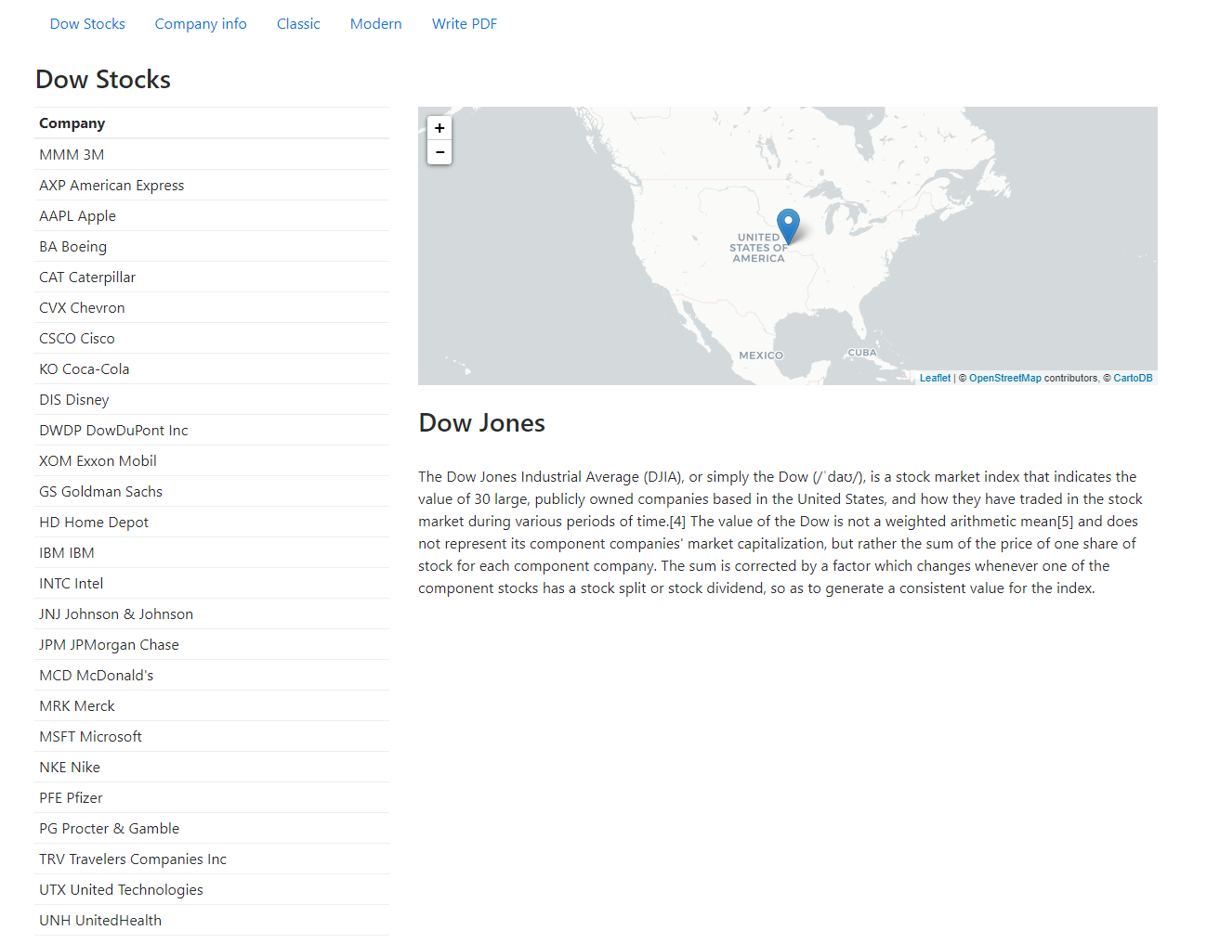

Slide 2
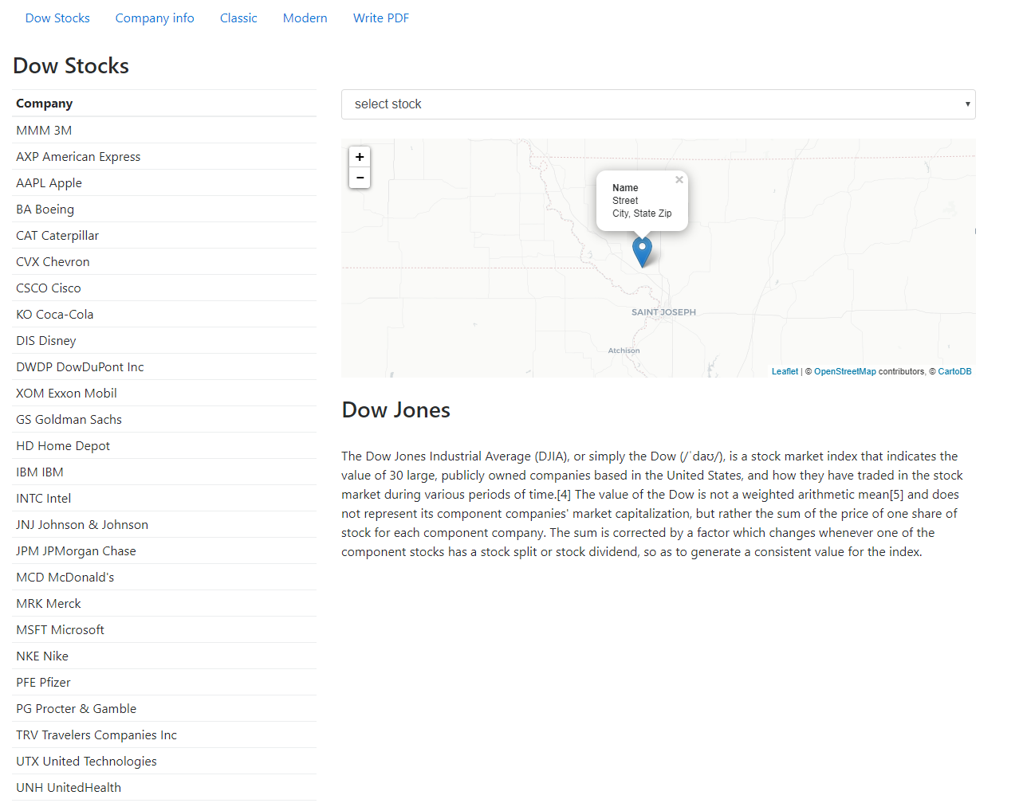


Stock Name
Stock Address

Slide 3
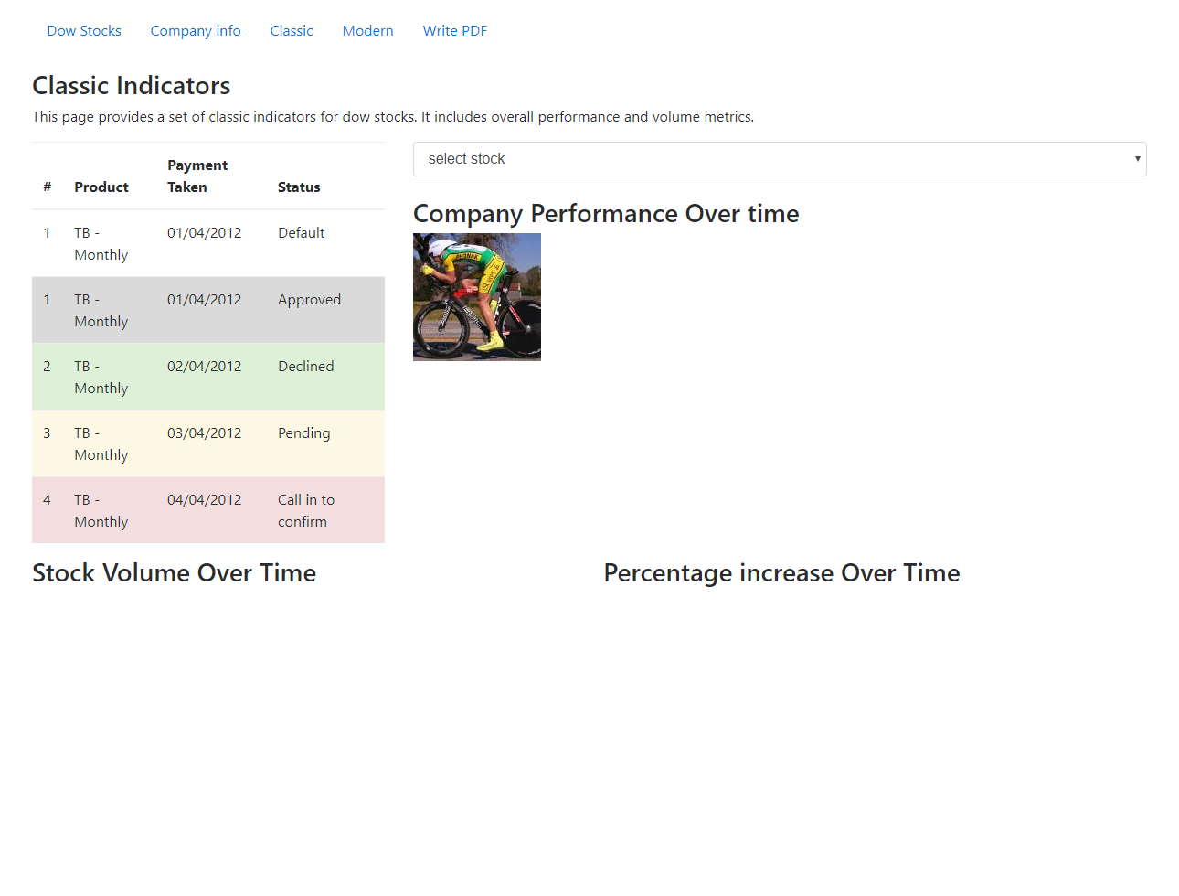
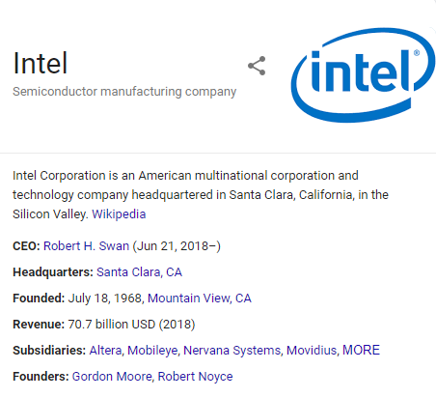
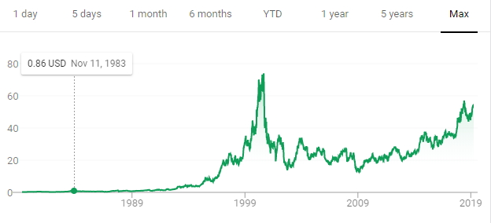
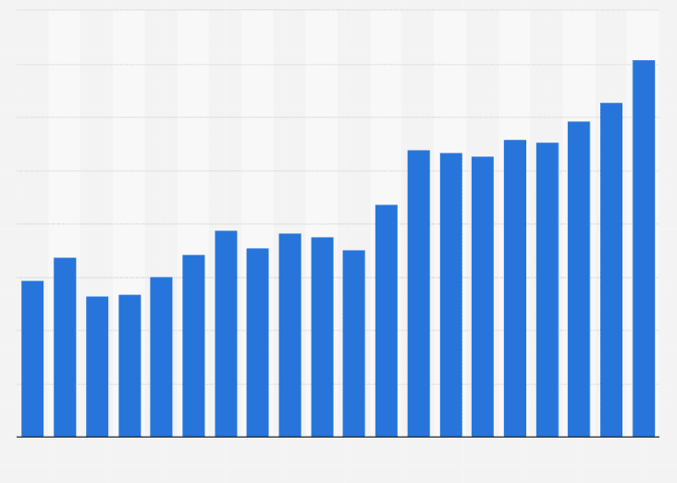

Slide 4

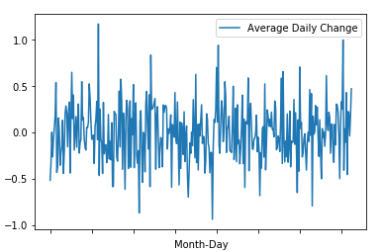



Average Daily Change by day of year
Largest one day increase
23%
4-5-2006
Largest one day loss
17%
12-3-1987
12-24
12-3
Up 67% of time
Down 87% of the time

Slide 5
